Slide 1



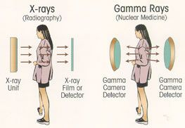
Interactions of radiation with Matter: Photons

Slide 2
Gamma and X-Ray Interactions
Gammas and x-rays differ only in their origin.
Both are:
  electromagnetic waves
  0 rest mass
  no net electrical charge
  travel at c (speed of light)
Differ from radio and visible light only because they have much shorter λ.
The difference in name is to indicate their origin:
  Gamma-rays originate in the nucleus
  X-rays originate in the electron cloud

Slide 3
Major Gamma Interactions
Three major mechanisms and one minor mechanism in which gamma rays interact with matter
  Photoelectric effect
  Compton scattering
  Pair Production/Annihilation
  Photodisintegration

Slide 4
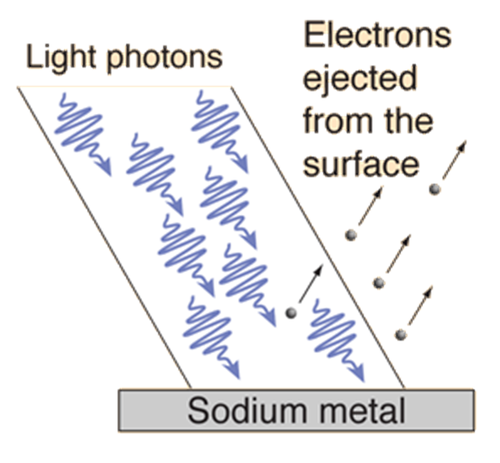
Photoelectric Effect
Einstein, 1905, as part of his Nobel prize winning paper on the photon theory of light - a prediction which was later verified experimentally in detail
Photon absorbed by atom, goes into excited state and ejects an electron with excess kinetic energy:
http://hyperphysics.phy-astr.gsu.edu/hbase/mod1.html#c2

Slide 5
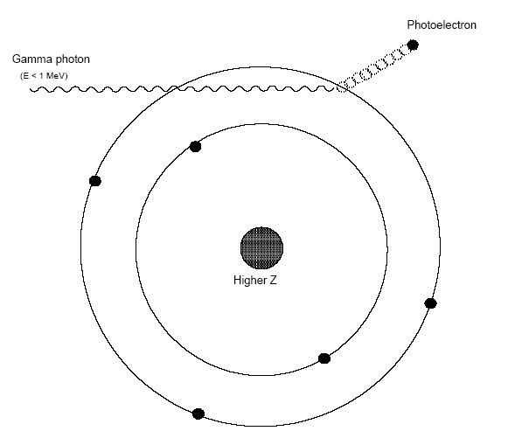
Photoelectric Effect cont’d
All-or-none energy loss.
Gamma gives all its energy to an orbital e⁻.
The gamma vanishes and the e- (photo e-) is ionizing particle and can knock other e- in other atoms from their orbits.
Continues until all its energy is gone.
Energy is given to orbital e- in KE of motion, overcomes the binding energy and usually causes the electron to fly out from its orbit with great velocity. An ion-pair results.

Slide 6
Photoelectric Effect cont’d
The highest probability for the photoelectric effect occurs when E_{γ} = BE_{e}- .
The tighter an electron is bound to the nucleus, the higher the probability of photoelectric effect, so most photoelectrons are inner-shell electrons.
Primarily an effect of low energy photons with energies near the electron binding energies of materials and high Z materials whose inner-shell electrons have high binding energies.
Photoelectron energy is given by E_{pe} = hf – Φ where (hf = photon energy (Planck’s Constant x Frequency) and Φ is the ionization potential)

Slide 7
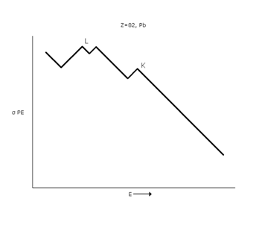
Photoelectric Effect cont’d
PE effect is favored by low energy photons and high atomic numbered absorbers
Cross section varies as Z⁴/E³
So Pb is an ideal absorber for low energy photons and x-rays
Leaded aprons???

Slide 8
Compton Scattering
Wave interpretation predicts that when electromagnetic radiation is scattered from a charged particle, the scattered radiation will have the same frequency as the incident radiation in all directions
The scattering of electromagnetic radiation from a charged particle is viewed as a perfectly elastic billiard ball

Slide 9
Compton Scattering cont’d
The probability of a Compton interaction increases for loosely bound electrons.
So, most Compton electrons are valence electrons.
Compton scattering is primarily seen as an effect of medium energy photons.
Energy transferred given by equations:

Slide 10
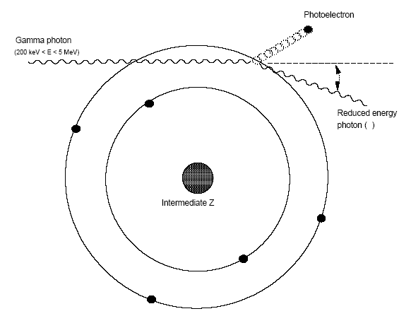
Compton Scattering cont’d

Slide 11
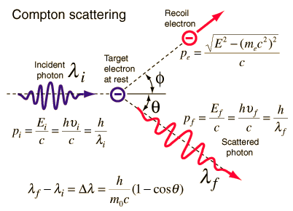
Compton Scattering cont’d
Basically, a γ scatters from an electron.
γ interacts with orbital e- and only part of the energy is transferred to e-
γ continues on with less E and different direction.
This “scattered” γ continues on until it loses more energy in another interaction.
Compton e- produces 2ndary ionization like the photoelectron

Slide 12
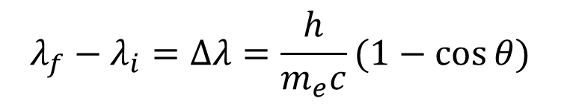

Compton Scattering cont’d
To the standard Compton formula for the change in λ
Relation between the scattering angles of the photon and the electron is:
Equation shows that the e- can’t be scattered >90º
$$λ_{f}−λ_{i}=Δλ=\frac{h}{m_{e}c}(1−\cos{θ)}$$
$$Δλ=0.0242 (1−\cos{θ})\dot{Α}$$

Slide 13
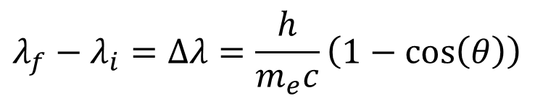
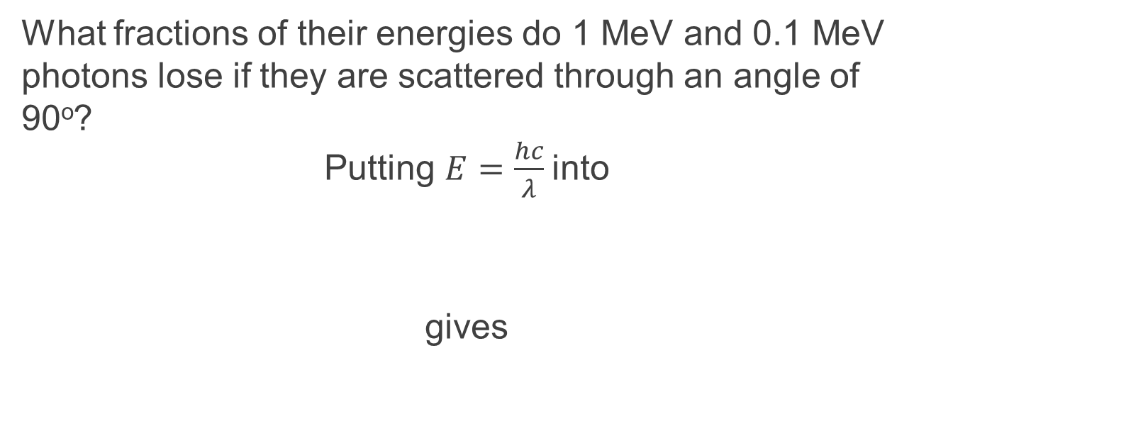
Problem
What fractions of their energies do 1 MeV and 0.1 MeV photons lose if they are scattered through an angle of 90º?
Putting $E=\frac{hc}{λ}$into
gives
$$λ_{f}−λ_{i}=Δλ=\frac{h}{m_{e}c}\left(1−\cos\left(θ\right)\right)$$

Slide 14
Problem (continued)
Subbing in values of incident photon and scattering angle
Fractional energy loss is
For the 0.1 MeV gammas, the scattered photon energy is 0.0835 MeV, and the fractional energy loss is only 16.5%

Slide 15
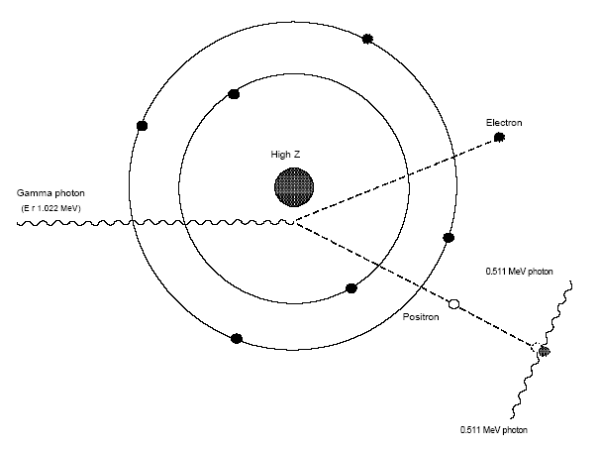
Pair Production
The γ ray disappears near the nucleus and an electron/positron “pair” appear.
The mass of these e- has been created from the energy of the photon, according to E = mc².
Any excess energy is shared at KE.
The electron behaves in the ordinary way, making secondary ion-pairs until it loses all of its energy of motion.

Slide 16
Pair Production
Probability of pair production is lower than PE and Compton because the photon must be close to the nucleus. Increases for high Z and high energies
σ_{pp} ~ Z²
Occurs when all of the photon energy is converted to mass.

Slide 17
Pair Production cont’d
Occurs only in presence of strong electric field (acts as a catalyst). The strong fields are found near the nucleus and is stronger for high Z materials.
Must have more than 1.022 MeV energy.

Slide 18
Pair Production cont’d
Pair production, like photoelectric absorption, involves a process wherein the incident photon disappears completely.
The first difference between these interaction modes lies in the prospective target:
  Photoelectric effect is accomplished through the interaction of a photon with a bound electron, whereas pair production usually occurs as an interaction between an incident photon and the field surrounding the target nucleus.

Slide 19
Pair Production cont’d
The second difference lies within the minimum or threshold energy requirements for pair production.
Pair production gets its name from the fact that a matter—anti-matter doublet of particles is produced when the photon interacts with the coulomb field of a nucleus.

Slide 20
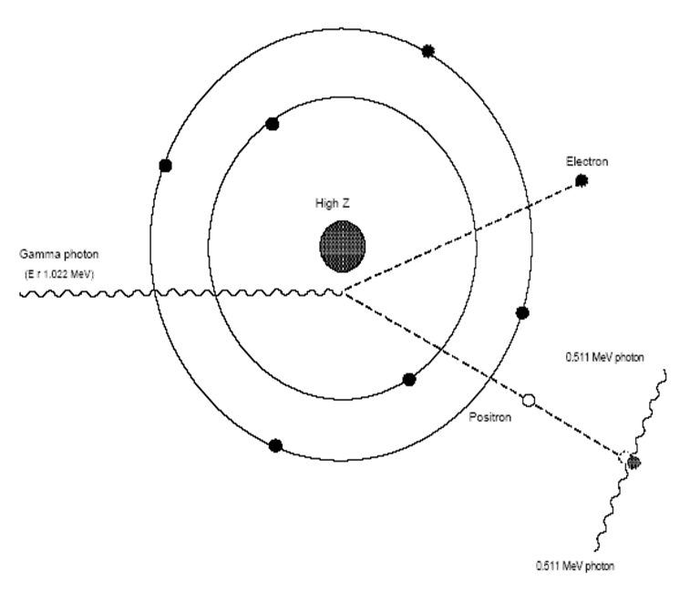
Annihilation
The inverse of pair production can also occur
In pair annihilation a positron-electron pair is annihilated, resulting in the creation of 2 (or more) photons as shown
At least 2 photons must be produced in order to conserve energy and momentum

Slide 21
Annihilation cont’d
Their masses are converted back into pure energy. Thus, two gammas of 0.511 MeV each arise at the annihilation site (accounting for the rest mass of the particles).
The ultimate fate of the "annihilation gammas" is either photoelectric absorption or Compton scattering followed by photoelectric absorption.

Slide 22
Photodisintegration
Absorber nucleus captures a γ-ray and in most instances emits a neutron:
⁹Be(γ,n) ⁸Be
Important for high energy photons from electron accelerators
Cross-sections are « total cross-sections

Slide 23
Combined Effects
Total attenuation coefficient μ
In computing shielding design, the above equation is used
This is the fraction of the energy in a beam that is removed per unit distance of absorber

Slide 24
Combined Effects
The fraction of the beam's energy that is deposited in the absorber considers only the energy transferred by the photoelectron, Compton electron, and the electron pair
Energy carried away by the scattered photon in a Compton interaction and by annihilation after PP is not included.
The energy absorption coefficient is given by
It is used in calculation of radiation dose

Slide 25
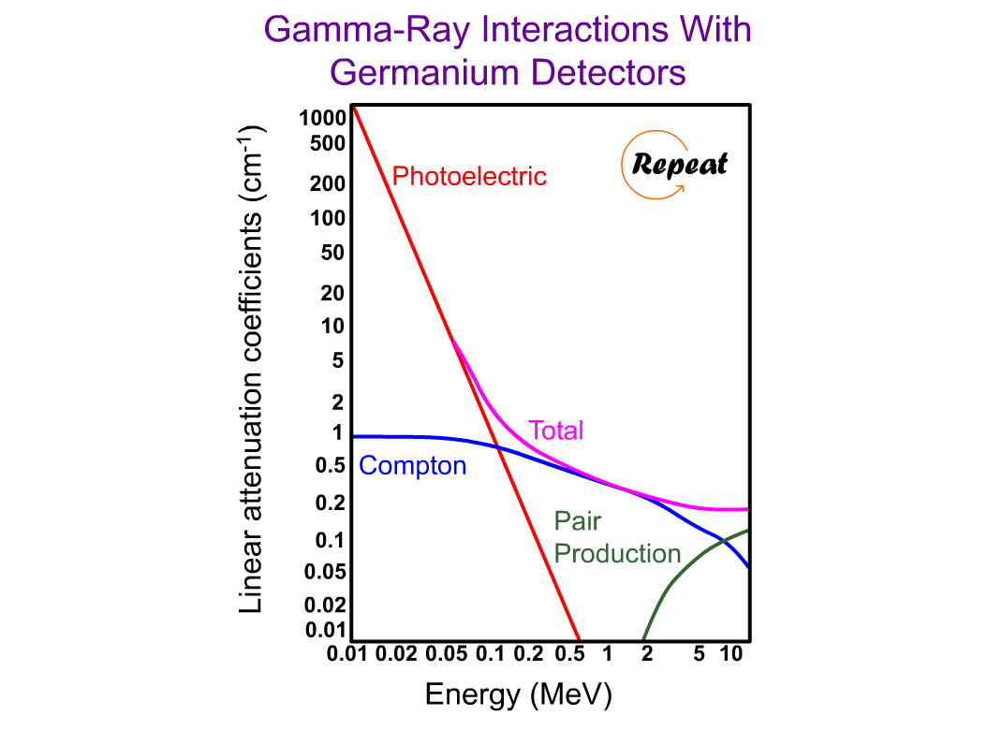

Slide 26
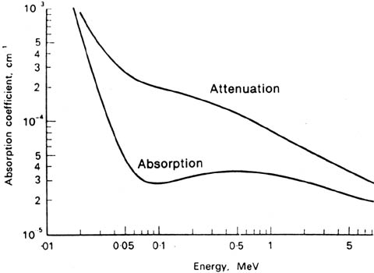

Slide 27
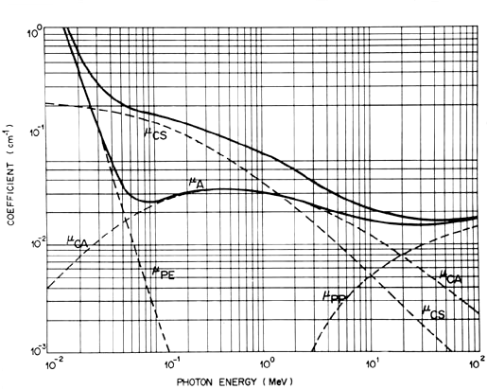
Linear Attenuation and Absorption Coefficients for Photons in Water

Slide 28
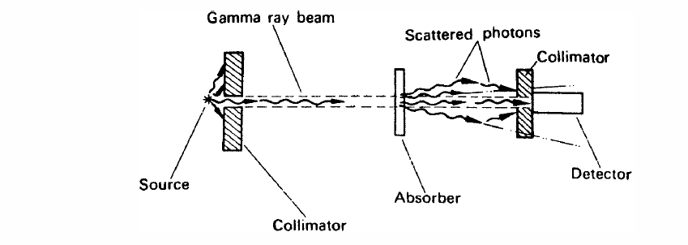
Exponential Absorption
Whereas charged particles have definite ranges in matter, photons are only reduced in intensity by increasingly thicker absorbers, or more dense substances.
Under the conditions of “good geometry,” changes in gamma-ray intensity can be reasonably calculated.
“Good geometry” is defined as a well-collimated, narrow beam.

Slide 29
Exponential Absorption
Due to the different interaction of γ-rays with matter, the attenuation is different than with α or β particles
Intensity of a beam of photons will be reduced as it passes through material because they will be removed or scattered by some combination of photoelectric effect, Compton scattering and pair production
Reduction obeys the exponential attenuation law:

Slide 30
Exponential Absorption
I = I_{o}e^{-μt}
where:
I₀ = γ-ray intensity at zero absorber
thickness
t = absorber thickness
I = γ-ray intensity transmitted
μ = attenuation coefficient
If the absorber thickness is measure in cm, then μ is called linear attenuation coefficient (μ_{l}) having dimensions "per cm"

Slide 31

Exponential Absorption
If the absorber thickness "t" is measured in g/cm², then (μ_{m}) is called mass attenuation coefficient (μ_{m}) having dimensions cm²/g
where ρ is the density of the absorber

Slide 32
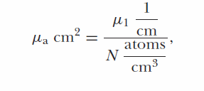
Exponential Absorption
For some purposes, it is useful to use the atomic attenuation coefficient, μ_{a}.
The atomic attenuation coefficient is the fraction of an incident gamma-ray beam that is attenuated by a single atom.
Another way of saying the same thing is that the atomic attenuation coefficient is the probability that an absorber atom will interact with one of the photons in the beam.
The atomic attenuation coefficient may be defined by the equation

Slide 33


Exponential Absorption
where N is the number of absorber atoms per cm3. Note that the dimensions of μ_{a} are cm², the units of area.
For this reason, the atomic attenuation coefficient is almost always referred to as the cross section of the absorber.
The unit in which the cross section is specified is the barn, b. 1b = 10⁻²⁴ cm².
The atomic attenuation coefficient is also called the microscopic cross section and is symbolized by σ, while the linear attenuation coefficient is often called the macroscopic cross section and is given by the symbol Ʃ

Slide 34


Exponential Absorption
What percent of an incident x-ray passes through a 5 mm material whose linear absorption is 0.07 mm-1?
$$\frac{I}{I_{0}}=e^{−μx}$$
$$=e^{−\left(0.07 mm^{−1}\right)\left(5.0 mm\right)}$$
$$=0.705 or 70.5\% passes through$$

Slide 35
Exponential Absorption cont’d
Suppose that we have a source of gamma rays whose energy is 1 MeV and the activity of the source is emitting 10⁸ gammas per second in a collimated, narrow beam in the direction of a radiation detector.
There exists a 1-cm thick Pb shield between the source and detector. What is the final intensity?

Slide 36


Exponential Absorption cont’d
From our intensity equation…
  What are the knowns?
  I₀ = 10⁸ gammas per second
  t=1 cm
  What about $μ$?

Slide 37
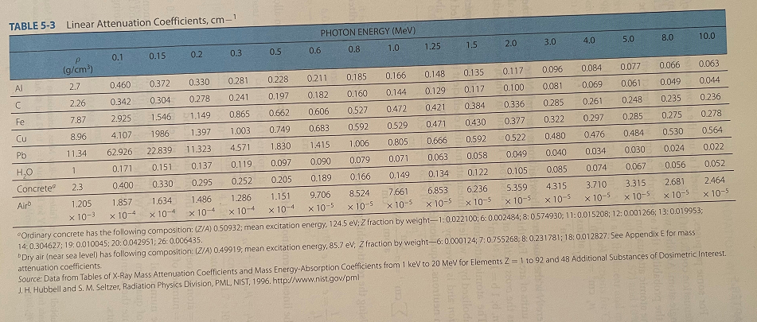

Linear Attenuation Coefficients Table 5.3

Slide 38

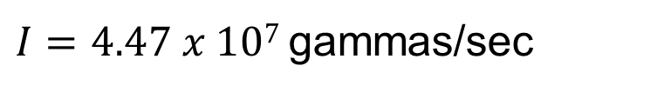
Exponential Absorption cont’d
From Table 5-3, μ=0.805 cm⁻¹
$$I={10}^{8}∗e^{−\left(0.805\right)\left(1.0\right)}=$$
$I=4.47 x 107$gammas/sec

Slide 39


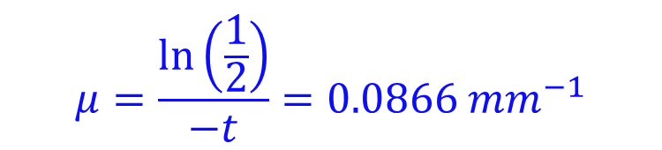
Exponential Absorption
A monochromatic beam of photons is incident on an absorbing material. If the intensity is reduced by a factor of 2 by a material 8 mm thick, what is the absorption coefficient?
$$I=I_{0}e^{−μt}$$
What is I? What about t?
$$\frac{I_{0}}{2}=I_{0}e^{−μ(8 mm)}$$
$$μ=\frac{\ln\left(\frac{1}{2}\right)}{−t}=0.0866 mm^{−1}$$

Slide 40



Exponential Absorption
What is the thickness of Al and Pb to transmit 10% of a 0.1 MeV γ-ray?
$$\frac{I}{I_{0}}=e^{−μt}= ?$$
$$\ln\left(\frac{1}{10}\right)=−μt$$
$$t=\frac{\ln\left(\frac{1}{10}\right)}{−μ}$$

Slide 41
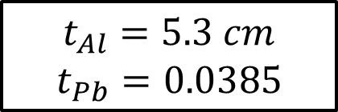
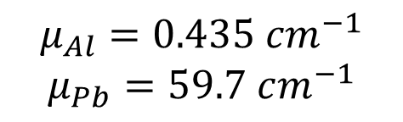
Exponential Absorption
$$μ_{Al}=0.435 cm^{−1}$$
$$μ_{Pb}=59.7 cm^{−1}$$
$$t_{Al}=5.3 cm$$
$$t_{Pb}=0.0385$$
If we have a 1.0 MeV γ - ray:

Slide 42
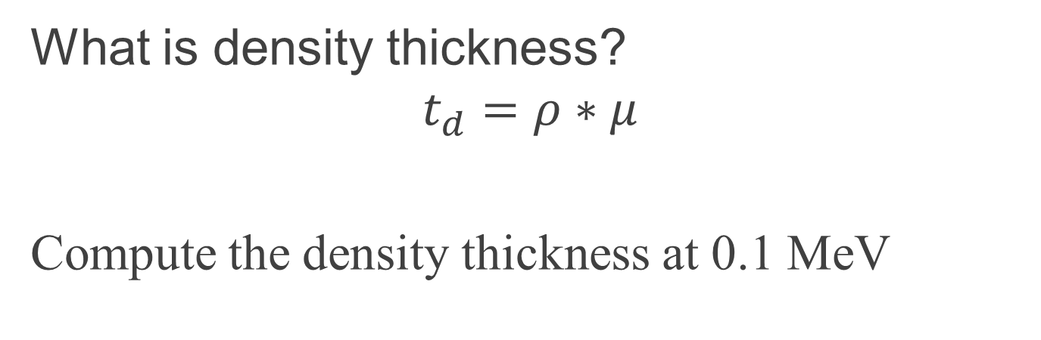
Exponential Absorption
What is density thickness?
$$t_{d}=ρ∗μ$$
Compute the density thickness at 0.1 MeV

Slide 43
Exponential Absorption
Compute the density thickness at 1 MeV
What does this tell us?
Pb is only slightly better on a mass basis than Al at 1 MeV
However, for low energy photons Pb is much better
In general, for energies between 0.8 → 5 MeV almost all materials, on a mass basis, have approximately the same γ-ray attenuating properties

Slide 44
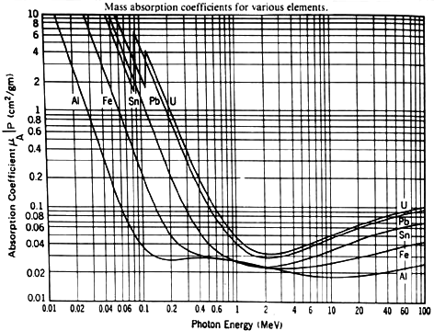

Slide 45
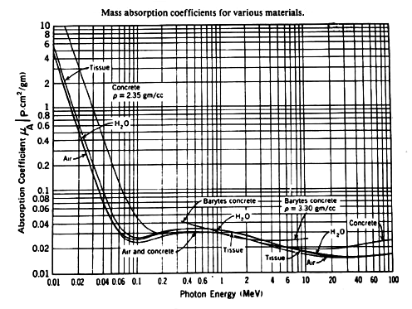

Slide 46
Photon Interactions- Problem
1-MeV photons are normally incident on a 1-cm lead slab
The mass attenuation coefficient of lead (density = 11.35 g/cm³) is 0.0708 cm²/g and the atomic weight is 207.2 g/mol

Slide 47
Photon Interactions - Problem
Calculate the linear attenuation coefficient
What fraction of 1-MeV photons interact in a 1-cm lead slab?
What thickness of lead is required for half the incident photons to interact?
Calculate the mean free path

Slide 48

Photon Interactions – Problem A
What is the linear attenuation coefficient?
$$μ_{l}=μ_{m}∗ρ$$
  μ = (0.0708 cm² g⁻¹) × (11.35 g cm⁻³)
  = 0.804 cm⁻¹.

Slide 49
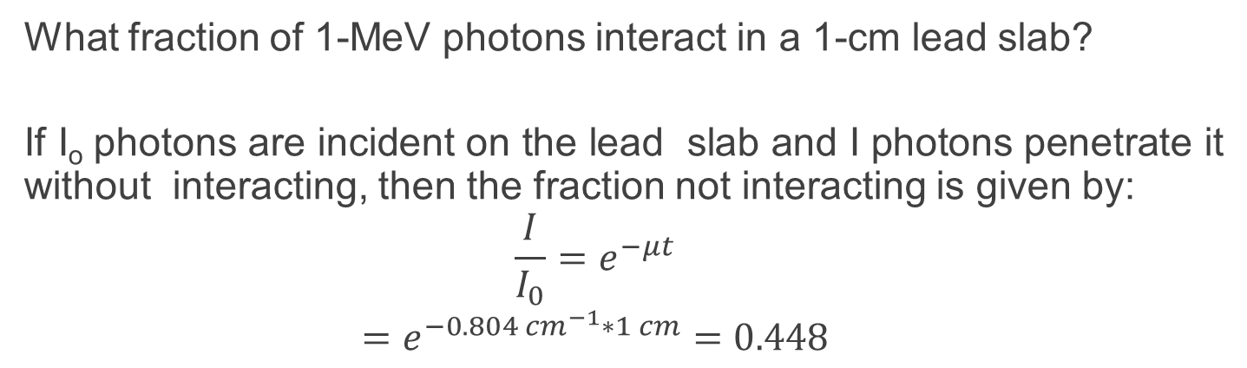
Photon Interactions – Problem B
What fraction of 1-MeV photons interact in a 1-cm lead slab?
If I_{o} photons are incident on the lead slab and I photons penetrate it without interacting, then the fraction not interacting is given by:
$$\frac{I}{I_{0}}=e^{−μt}$$
$$=e^{−0.804 cm^{−1}∗1 cm}=0.448$$
the fraction of photons interacting is:
1 - 0.448 = 0.552

Slide 50
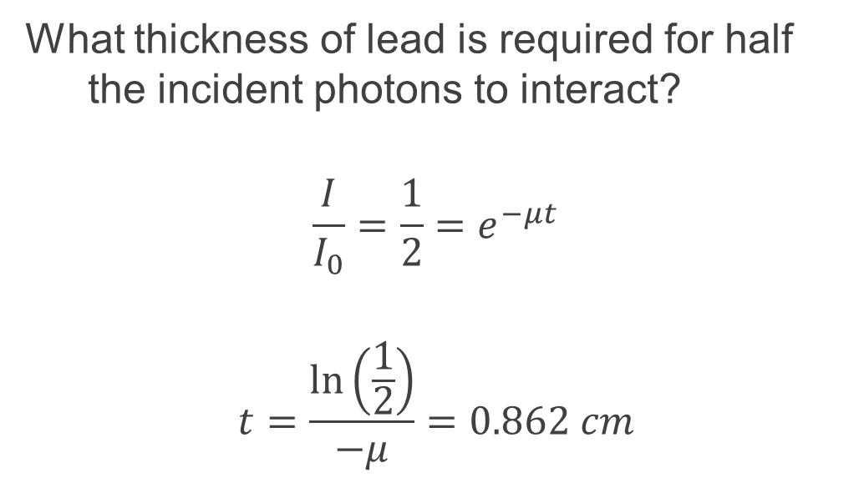
Photon Interactions – Problem C
What thickness of lead is required for half the incident photons to interact?
$$\frac{I}{I_{0}}=\frac{1}{2}=e^{−μt}$$
$$t=\frac{\ln\left(\frac{1}{2}\right)}{−μ}=0.862 cm$$

Slide 51
Photon Interactions – Problem D
Calculate the mean free path:
the mean free path (MFP) is the average distance that an incident photon travels before interaction and is the reciprocal of the attenuation coefficient:
MFP = 1/μ = 1/0.804 = 1.24 cm
This is also numerically equal to the "relaxation length“
the shield thickness needed to attenuate a narrow beam of monoenergetic photons to 1/e (= 0.368) of its original intensity and can be derived by substituting I/I_{o} = 1/e

Slide 52
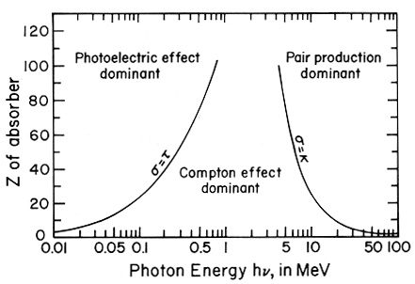
Comparison of photon interaction probabilities (by mode) as a function of atomic number and incident photon energy.

